Slide 1

Ethical Student Hackers
🎄 Holiday Hackery 🎄

Slide 2
The Legal Bit
The skills taught in these sessions allow identification and exploitation of security vulnerabilities in systems. We strive to give you a place to practice legally, and can point you to other places to practice. These skills should not be used on systems where you do not have explicit permission from the owner of the system. It is VERY easy to end up in breach of relevant laws, and we can accept no responsibility for anything you do with the skills learnt here.
If we have reason to believe that you are utilising these skills against systems where you are not authorised you will be banned from our events, and if necessary the relevant authorities will be alerted.
Remember, if you have any doubts as to if something is legal or authorised, just don't do it until you are able to confirm you are allowed to.

Slide 3
Code of Conduct
Before proceeding past this point you must read and agree to our Code of Conduct - this is a requirement from the University for us to operate as a society.
If you have any doubts or need anything clarified, please ask a member of the committee.
Breaching the Code of Conduct = immediate ejection and further consequences.
Code of Conduct can be found at https://shefesh.com/downloads/SESH%20Code%20of%20Conduct.pdf

Slide 4
Christmas Quiz
This is optional - but there are prizes up for grabs!
We’ll be doing a ‘buzzer’ system of answering - the first person to shout out the answer/type it in the chat gets the points, and then we move on to the next question!
Afterwards we’ll jump onto TryHackMe and sort out prizes :)
If you don’t want to take part, feel free to skip ahead in the slides (download them from shefesh.com/wiki/sessions) and get started on the Advent of Cyber Challenges
Good luck!

Slide 5


Round 1 - Cyber Say What You See
1)
?

Slide 6

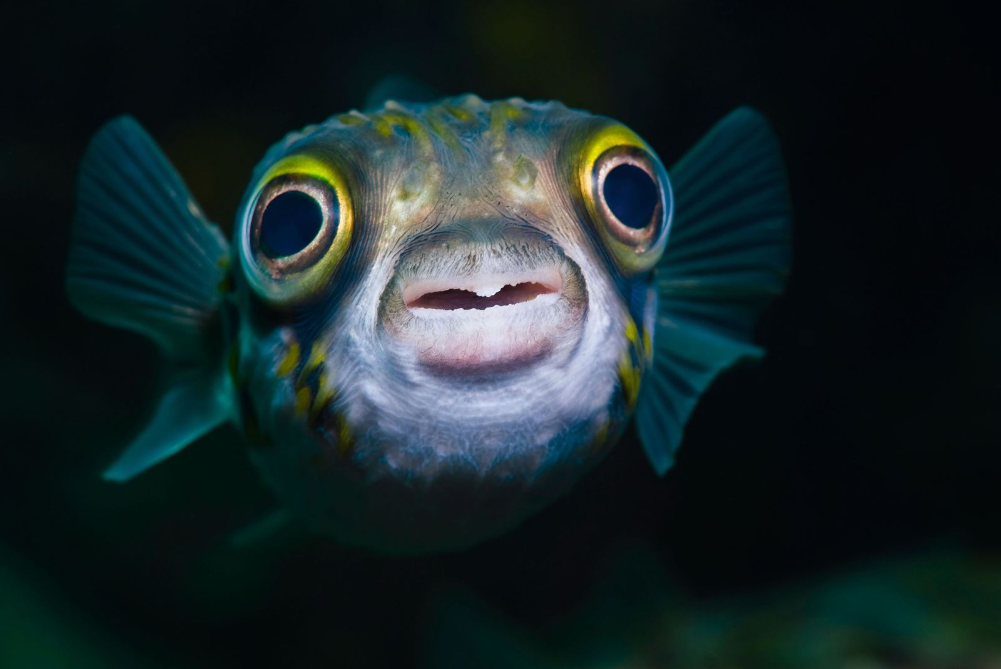

Round 1 - Cyber Say What You See
2)
?

Slide 7



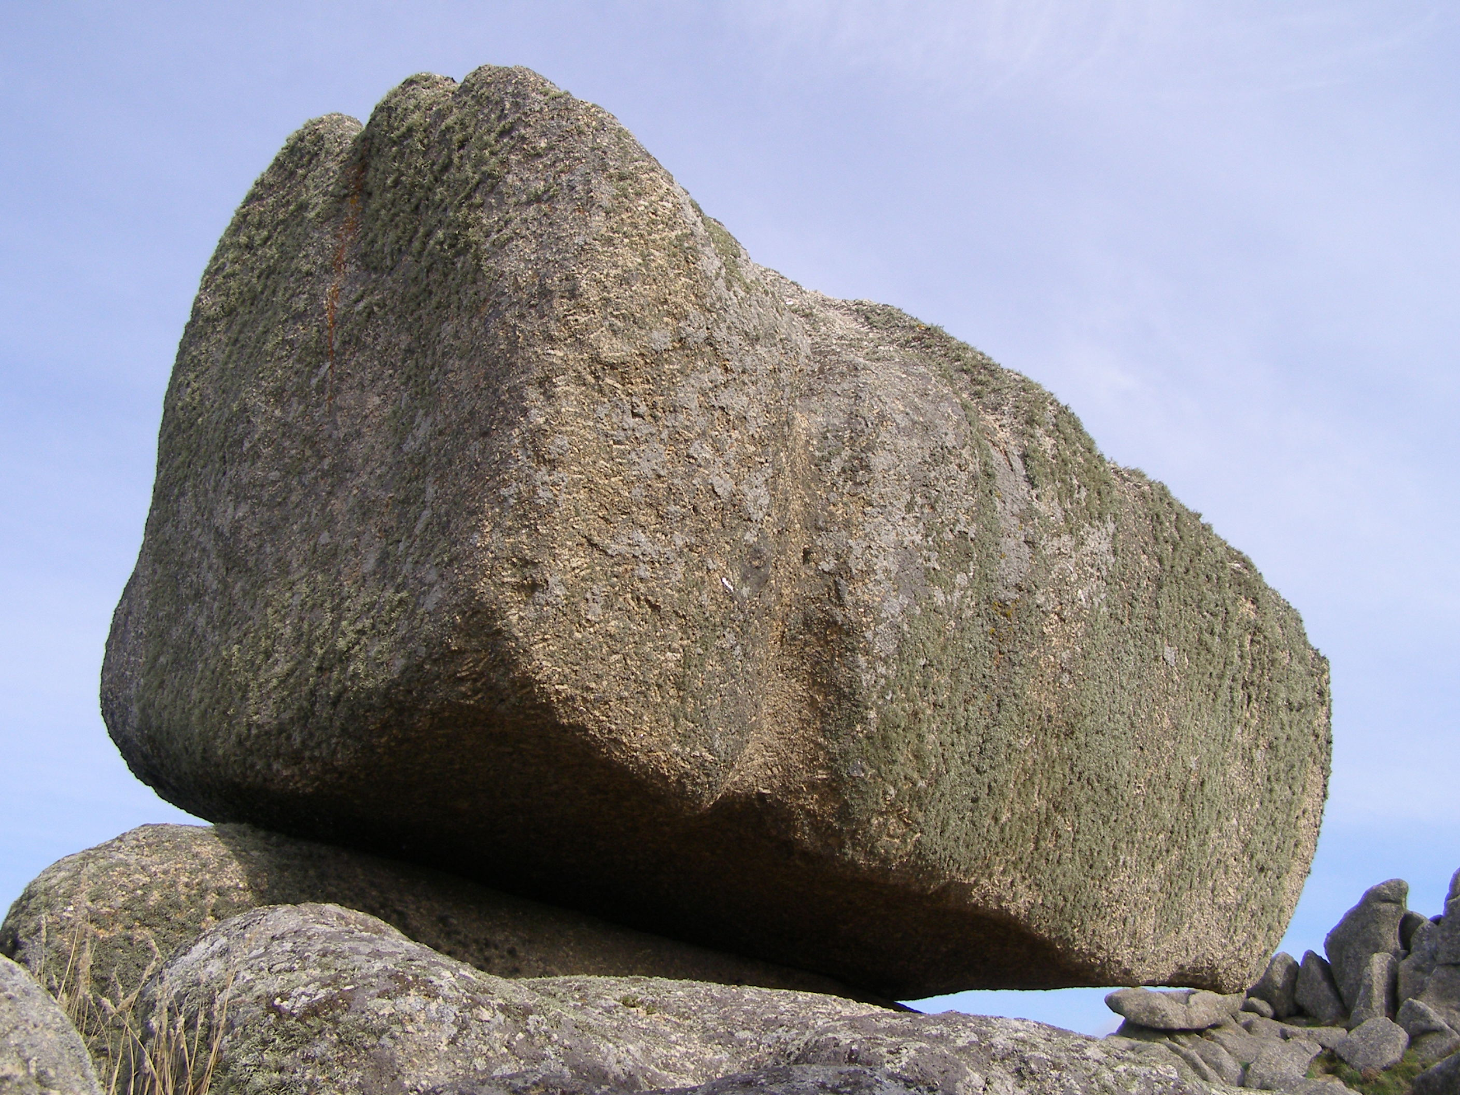
Round 2 - Xmas Say What You See
1)
( - “C” )
?

Slide 8





Round 2 - Xmas Say What You See
2)
?

Slide 9
Round 3 - Assorted Questions
Cyber Questions
How many TCP/UDP ports are there?
This NSA exploit is ‘eternally’ this colour
If you are sniffing for VoIP traffic, should you look for TCP or UDP?
What does the so-called ‘Layer 8’ of the OSI model represent?
What is the name of the famous malware that disrupted a country’s nuclear program?
Xmas Questions
How many Reindeer does Santa have?
Traditional Christmas plants are ‘forever’ this colour
What animated 2004 film is about a train that carries kids to the North Pole on Christmas Eve?
What is the white layer on a Christmas cake made of?
From which country does Glühwein originate?

Slide 10
Advent of Cyber
Using TryHackMe
Create a TryHackMe account
https://tryhackme.com/
Download the OpenVPN file
tryhackme.com/access
Connect to the OpenVPN server
sudo openvpn [Path To File]
Equally on windows you can download the OpenVPN software from https://openvpn.net/client-connect-vpn-for-windows/
Join the TryHackMe Juice Shop room and start an instance by clicking ‘Deploy’
Boot up Kali, or use their web-based AttackBox (you only get an hour on a free account)
https://tryhackme.com/room/adventofcyber2

Slide 11

Advent of Cyber
A series of CyberSecurity challenges, with a new one released each day in the runup to Christmas
Aimed at beginners, with some harder challenges. They aim to cover the full spectrum of cyber!
Each question gets you an entry into a raffle with a HUGE prize pool :)
We’ll be going through them on screen, but take this session at your own pace and feel free to ask for help!

Slide 12
That’s it for Christmas!
Thank you for a fantastic first semester, and we look forward to seeing you in the new year!
Have a great Christmas break, and keep hacking!

Slide 13
Upcoming Sessions
Next week
The week after that
And the week after that
And the week after that
And the week after that
What’s up next?
www.shefesh.com/sessions

Slide 14

Any Questions?
www.shefesh.com
Thanks for coming!

